Slide 1

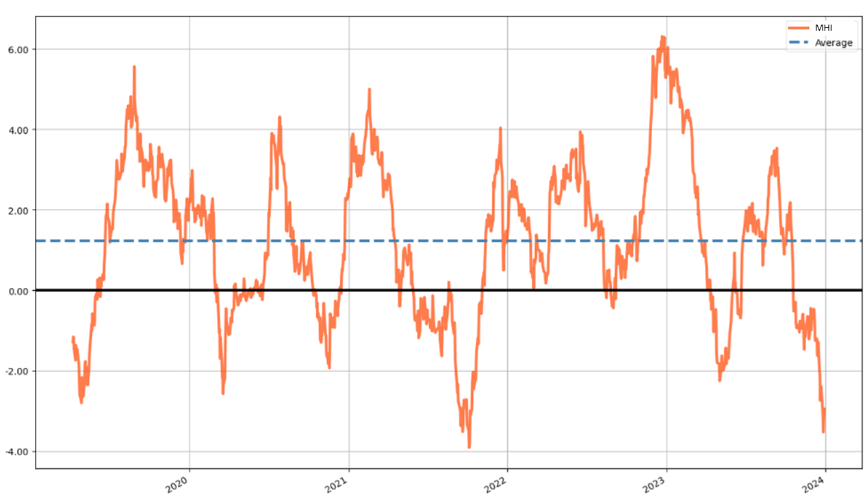
Market Health Index (MHI) - A mean-reverting index for trend detection
Downtrend Uptrend
PREV DOWNTREND
23.08.2021 – 21.09.2022 21.09.2021 – 16.12.2021 (I)
16.12.2021 – 24.02.2022 24.02.2022 – 07.06.2022 (II)
07.06.2022 – 16.08.2022 16.08.2022 – 27.12.2022 (III)
27.12.2022 – 09.05.2023 09.05.2023 – 11.09.2023 (IV)
11.09.2023 – 26.11.2023 NEXT UPTREND
(Last 5 years)

Slide 2
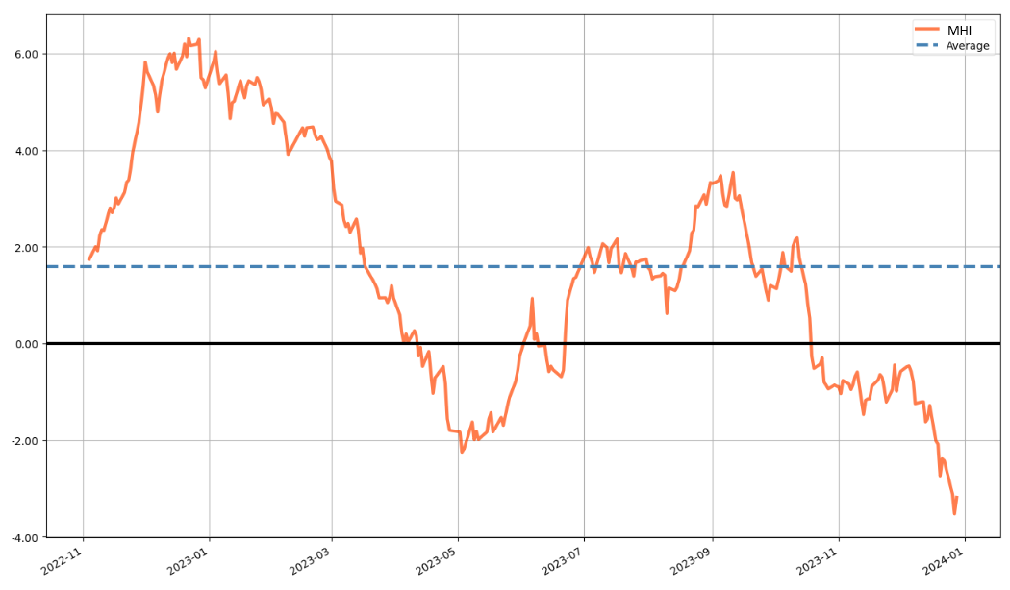
MHI - Last 365 days

Slide 3
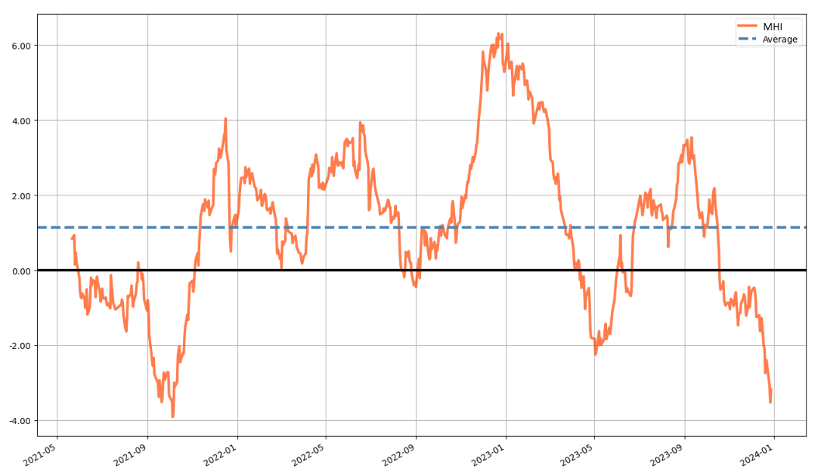
MHI - Last 730 days

Slide 4
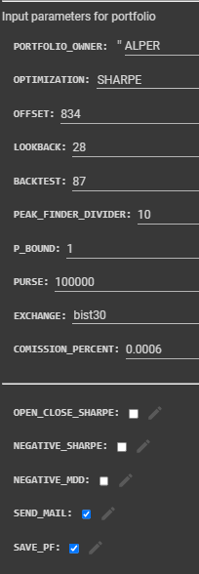
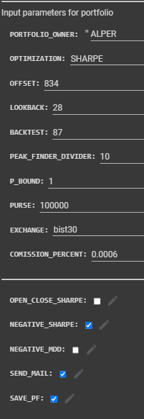
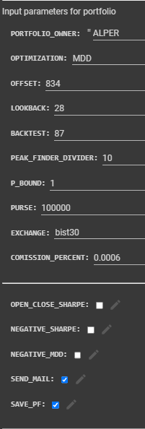
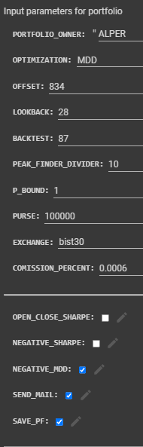
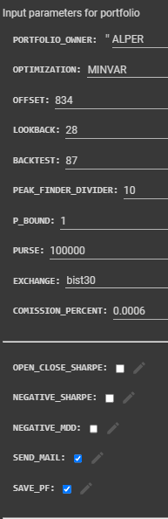
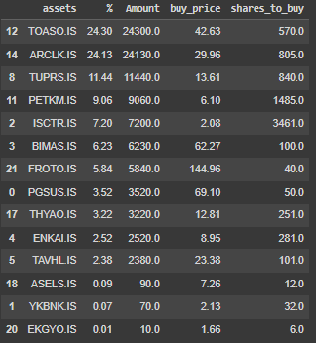

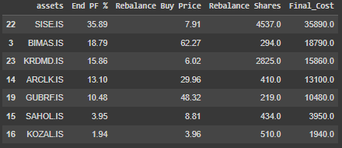

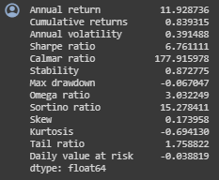
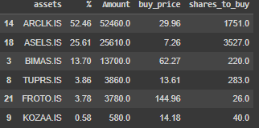
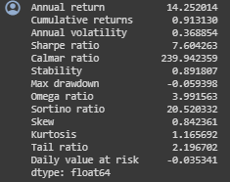
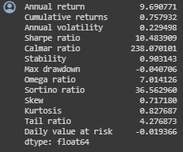
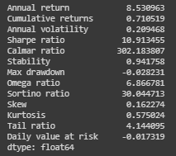
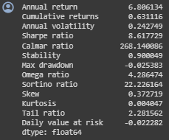
MHI portfolios for 21.09.2021 – 16.12.2021 (I)
Sharpe i-Sharpe MDD i-MDD MINVAR
Return: %91.3
SR: 7.6
MDD: %5.93
Return: %83.9
SR: 6.76
MDD: %6.7
Return: %75.8
SR: 10.48
MDD: %4
Return: %63.1
SR: 8.61
MDD: %2.53
Return: %71.1
SR: 10.91
MDD: %2.82

Slide 5
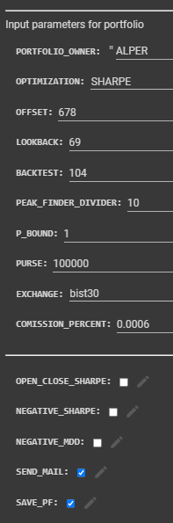
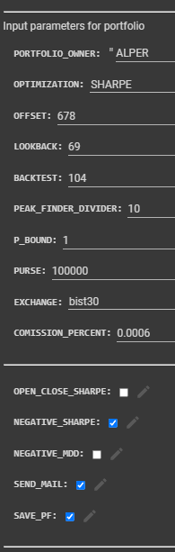
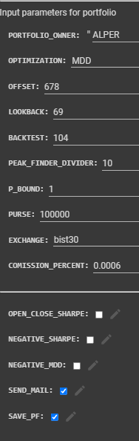
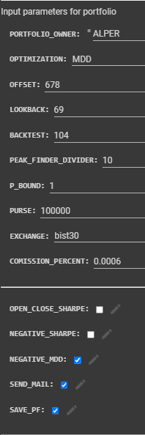
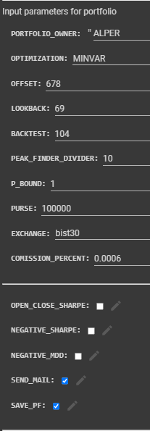

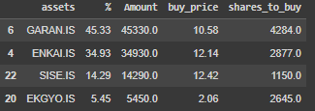


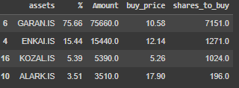
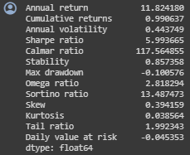
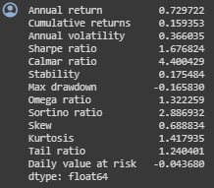
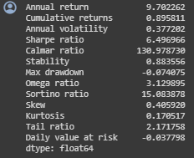
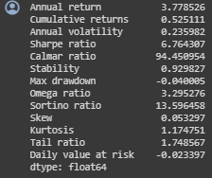
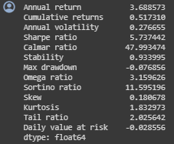
MHI portfolios for 24.02.2022 – 07.06.2022 (II)
Sharpe i-Sharpe MDD i-MDD MINVAR
Return: %99
SR: 5.99
MDD: %10.0
Return: %15.93
SR: 1.67
MDD: %16.58
Return: %89.6
SR: 6.49
MDD: %7.40
Return: %52.5
SR: 6.76
MDD: %4.0
Return: %51.7
SR: 5.73
MDD: %7.68

Slide 6
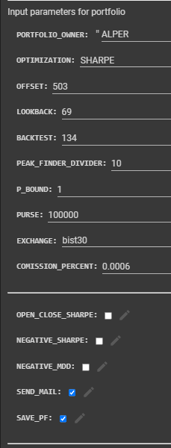
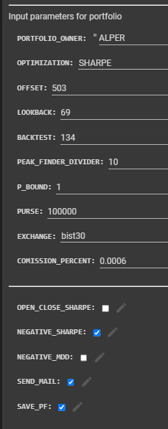
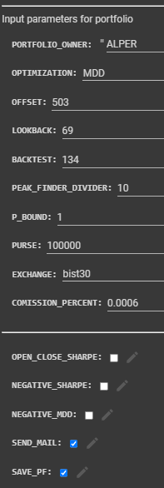
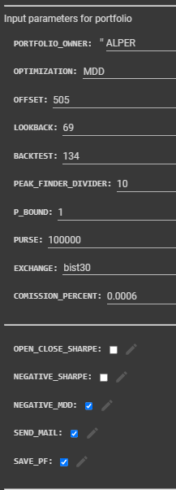
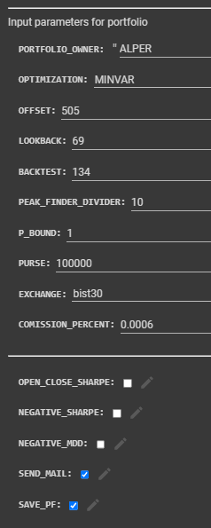
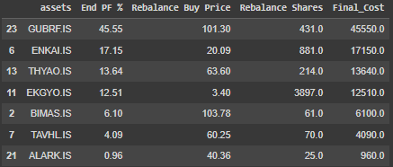
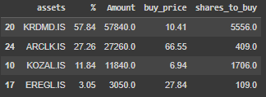
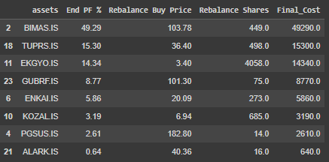

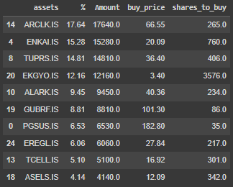
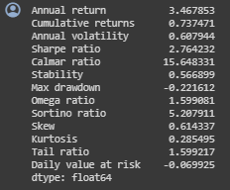
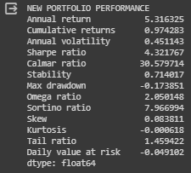
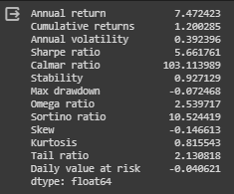
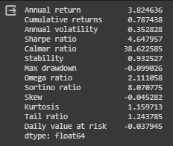
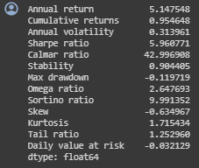
MHI portfolios for 16.08.2022 – 27.12.2022 (III)
Sharpe i-Sharpe MDD i-MDD MINVAR
Return: %73.7
SR: 2.76
MDD: %22.2
Return: %120
SR: 5.66
MDD: %7.2
Return: %97.4
SR: 4.32
MDD: %17.4
Return: %78.7
SR: 4.64
MDD: %9.9
Return: %95.5
SR: 5.96
MDD: %12.0

Slide 7
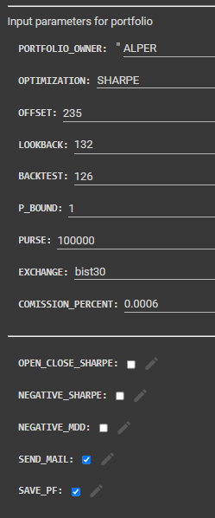
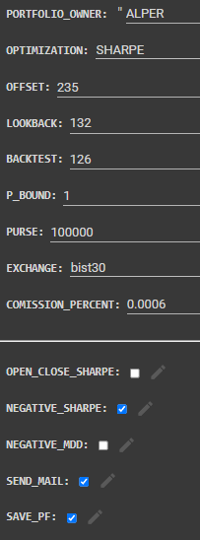
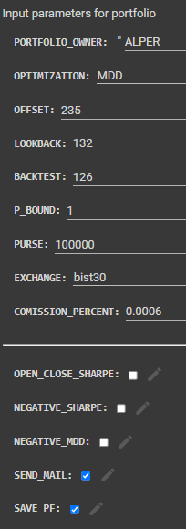
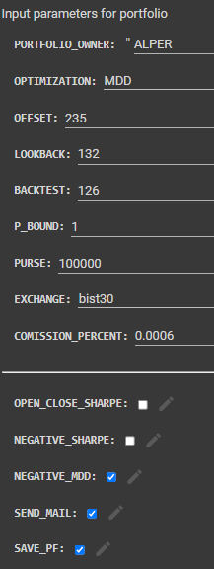
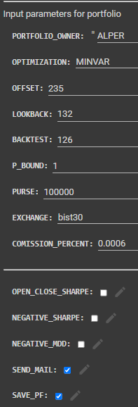

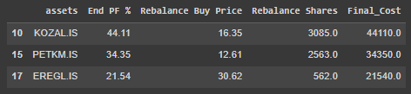
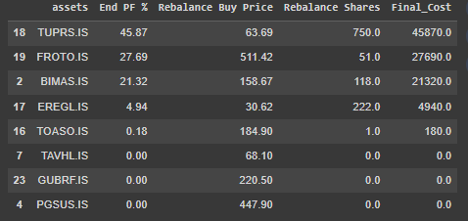

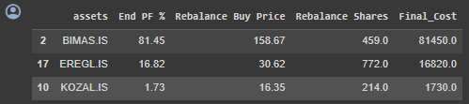





MHI portfolios for 09.05.2023 – 11.09.2023 (IV)
Sharpe i-Sharpe MDD i-MDD MINVAR
Return: %56.6
SR: 2.75
MDD: %13.7
Return: %65.6
SR: 3.39
MDD: %11.4
Return: %80.4
SR: 3.96
MDD: %16.1
Return: %64.3
SR: 3.96
MDD: %17.8
Return: %92.3
SR: 4.82
MDD: %12.4

Slide 8
Procedure for Portfolio Construction
Calculate and plot 1830 days (5 years) MHI
Detect peaks (MHI > 4) and valleys (MHI < -2)
Apply Correlation filter
At the valleys, starting from latest peak calculate portfolio and enter that portfolio.
At the first peak, sell the portfolio.

Slide 9

Filter for Correlation

Slide 10

Filter for Volatility

Slide 11


Minimums-Maximums

